Slide 1
Media and Entertainment Industry
Project

Slide 2
Team Members:
Anjali Atule
Varad Lad
Shubham Nisal
Rutuja Nandure

Slide 3
Scope of the System:
Profit - This module is to produce a report on Profitable store to increase its unit price per SKU. By analyzing the Sku’s sold each day and then coming up with a specific profit by department based on actual sku sales and costing. Dimension inventory fact which has the profit details.
Stock - SKU produces the items and the price details which are there in the SKU Master dimension to produce the SKU items, prices and discounts.
Production - This module is to find the Production of SKU’s based on Inventory Balance. SKU is an identification of a particular product that allows it to be tracked for inventory purposes. SKU Master is to get the information about the production details.

Slide 4
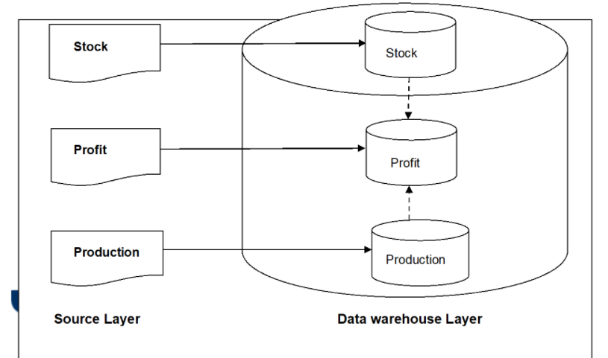
Logical Architecture:

Slide 5
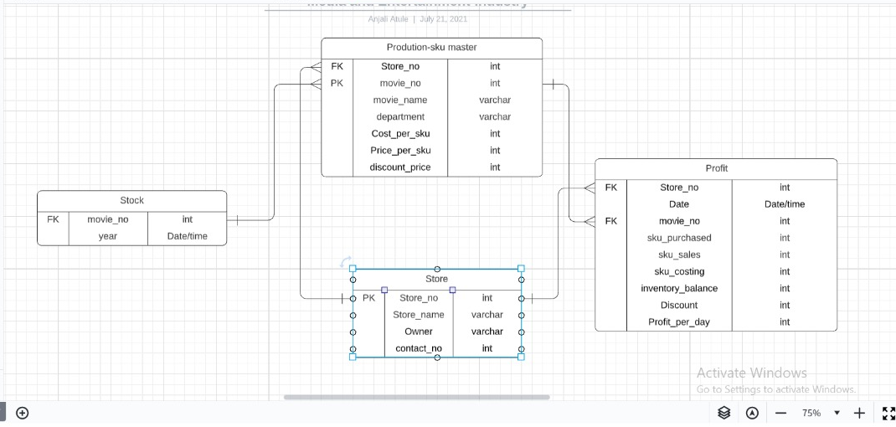
Project Model:

Slide 6
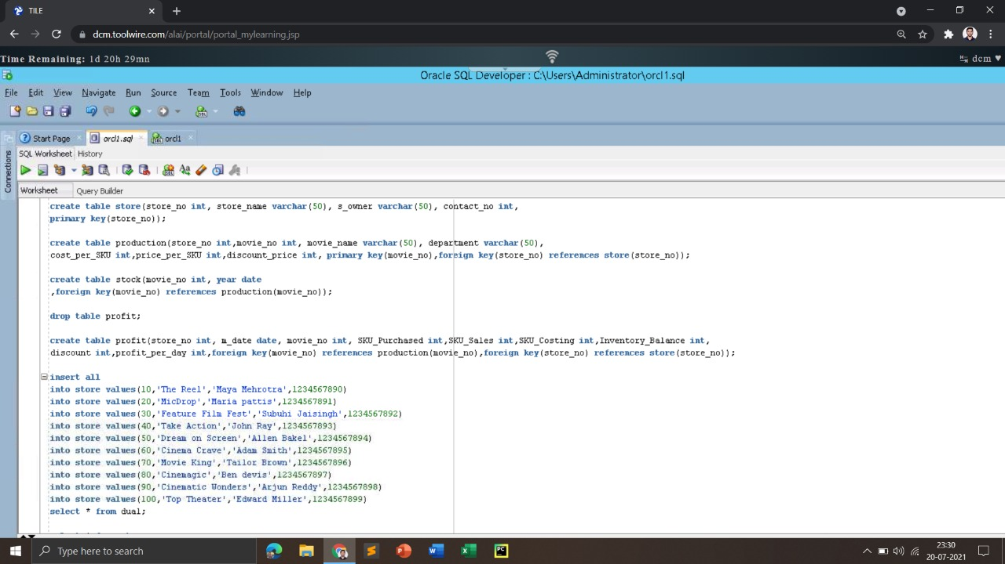
Creation of source tables:

Slide 7
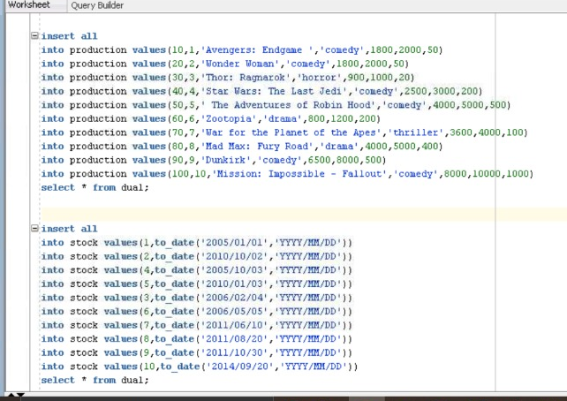
Inserting data into tables:

Slide 8
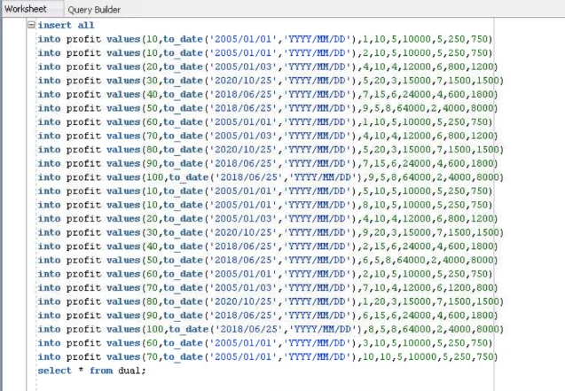
Inserting Data into Tables:

Slide 9
Modules

Slide 10
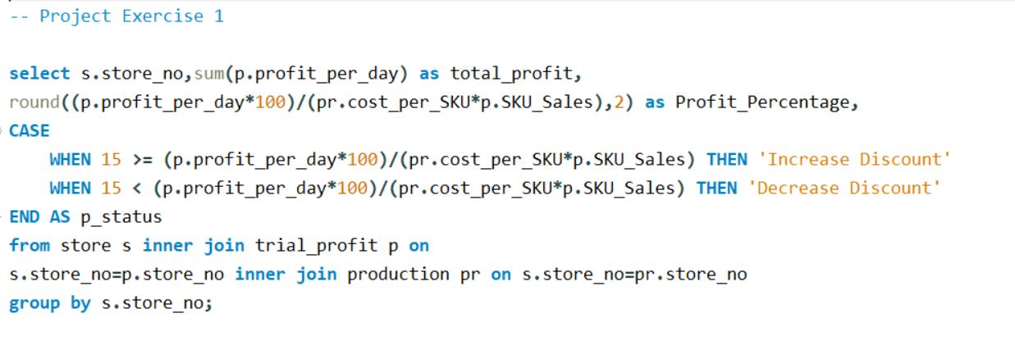
Exercise 1: To find the profitable stores and generate the report to check whether the discount has to increase.

Slide 11
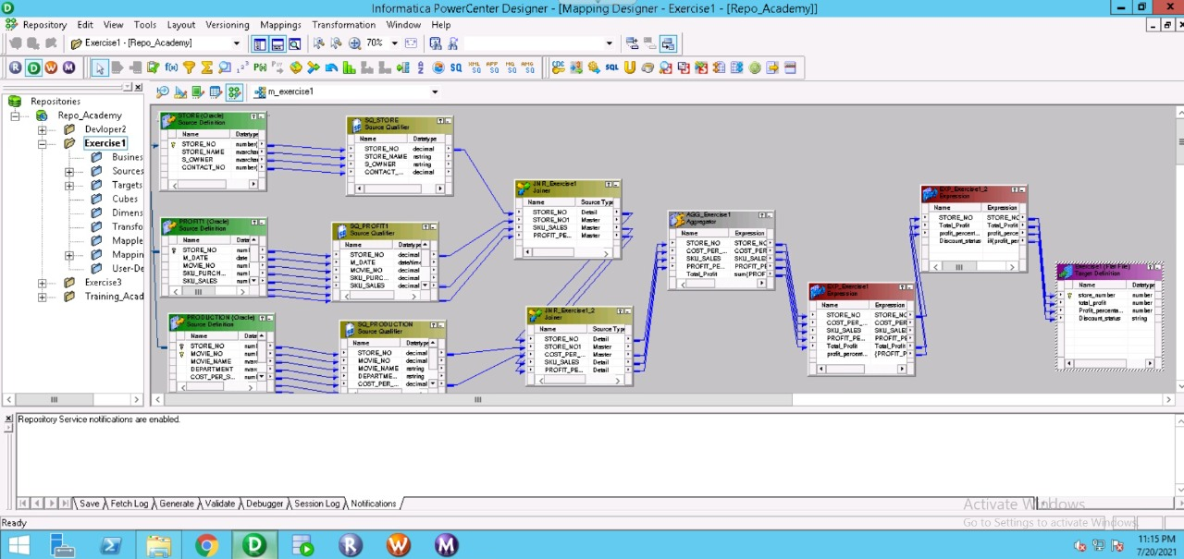
Exercise 1: To find the profitable stores and generate the report to check whether the discount has to increase.

Slide 12
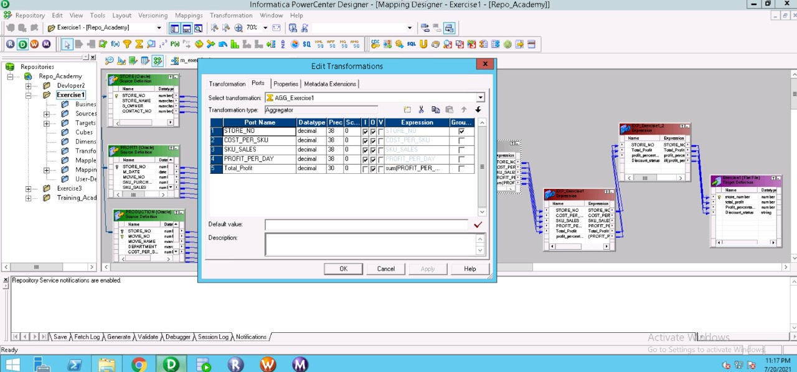
Exercise 1 (expression transformation):

Slide 13

Exercise 1 (expression transformation):

Slide 14
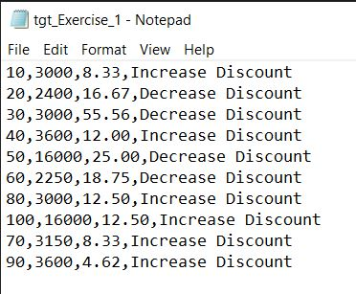
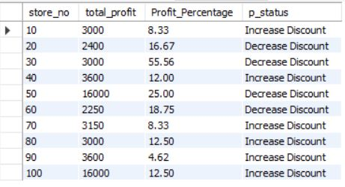
Target and Output 1:

Slide 15
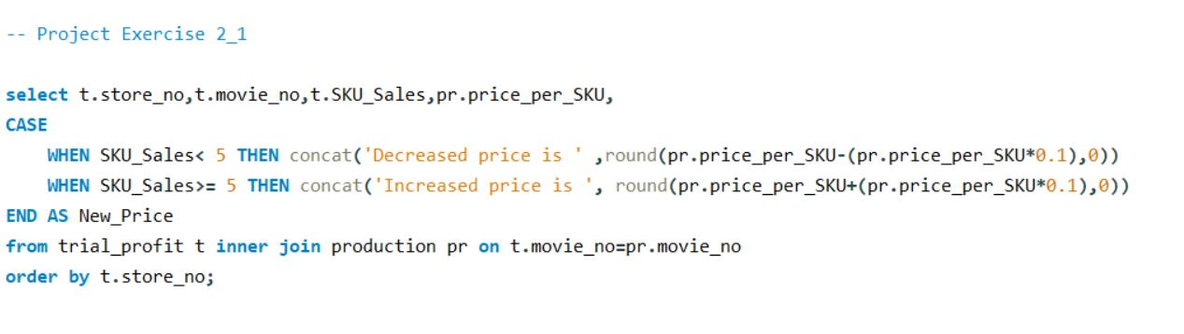
Exercise 2.1: This module is to produce a report on Profitable store to increase its unit price per SKU.

Slide 16
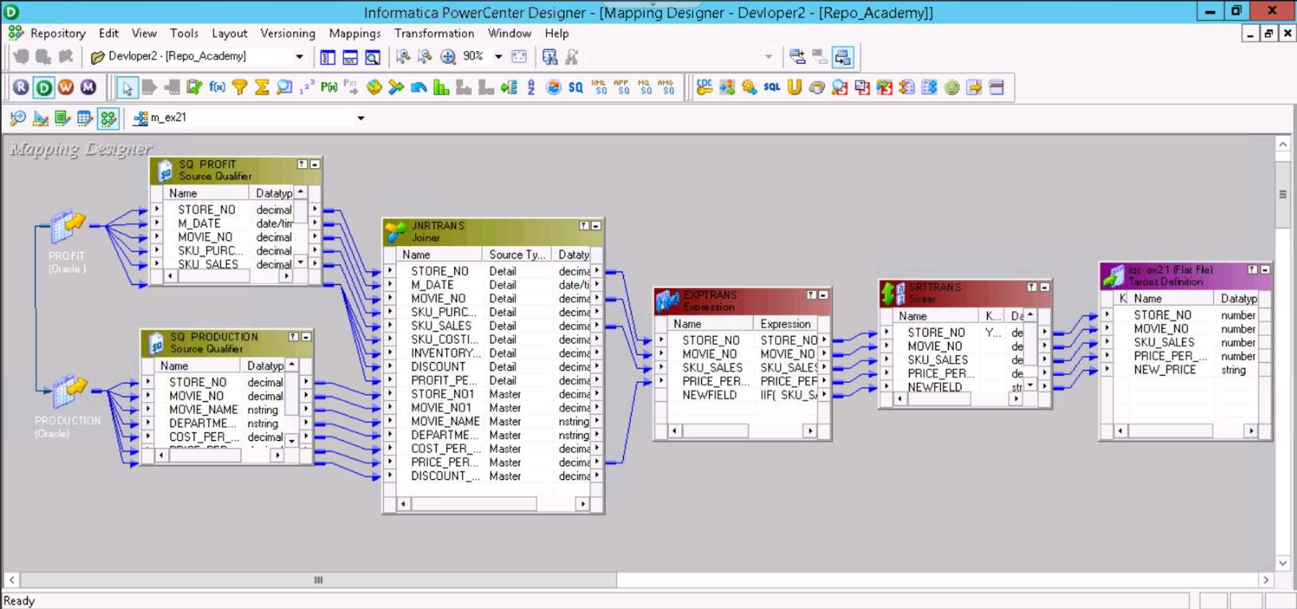
Exercise 2.1: This module is to produce a report on Profitable store to increase its unit price per SKU.

Slide 17
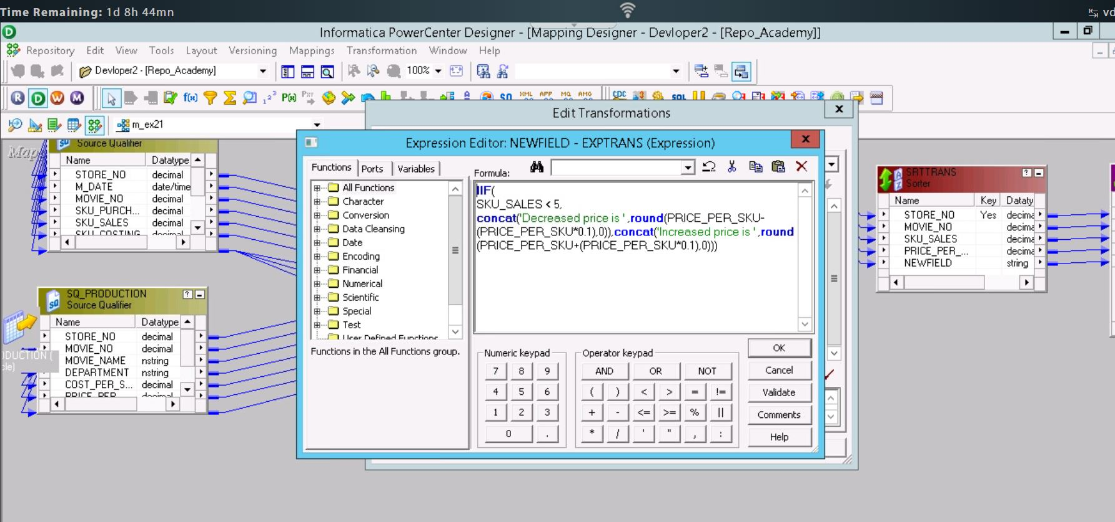
Exercise 2.1 (expression transformation):

Slide 18
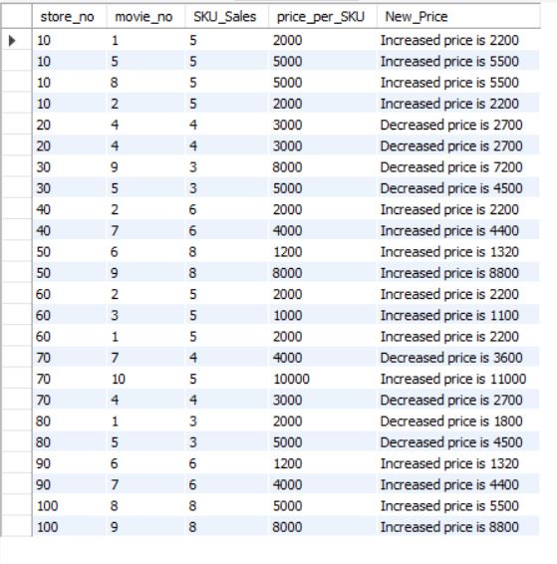
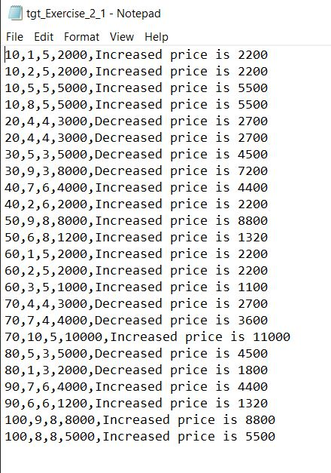
Target and Output 2.1 :

Slide 19
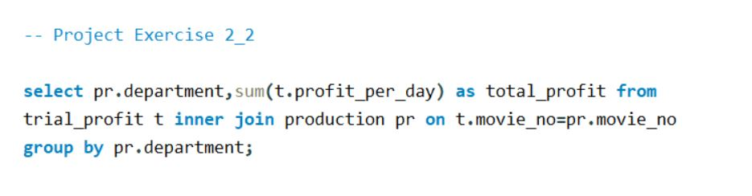
Exercise 2.2: By analyzing the Sku’s sold each day and then coming up with a specific profit by department based on actual sku sales and costing.

Slide 20
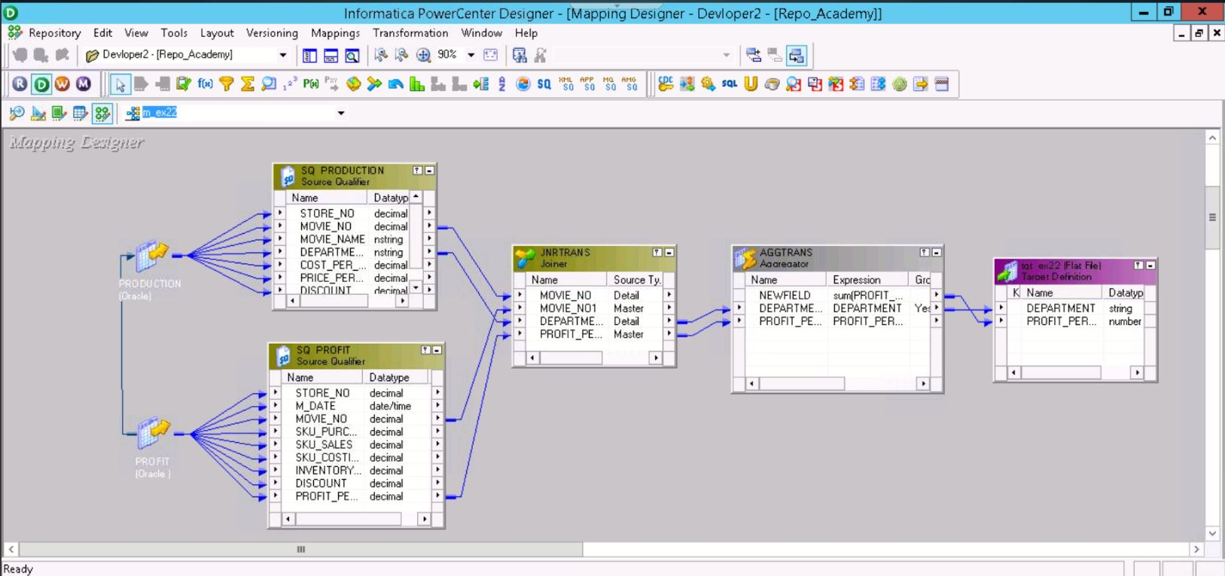
Exercise 2.2: By analyzing the Sku’s sold each day and then coming up with a specific profit by department based on actual sku sales and costing.

Slide 21
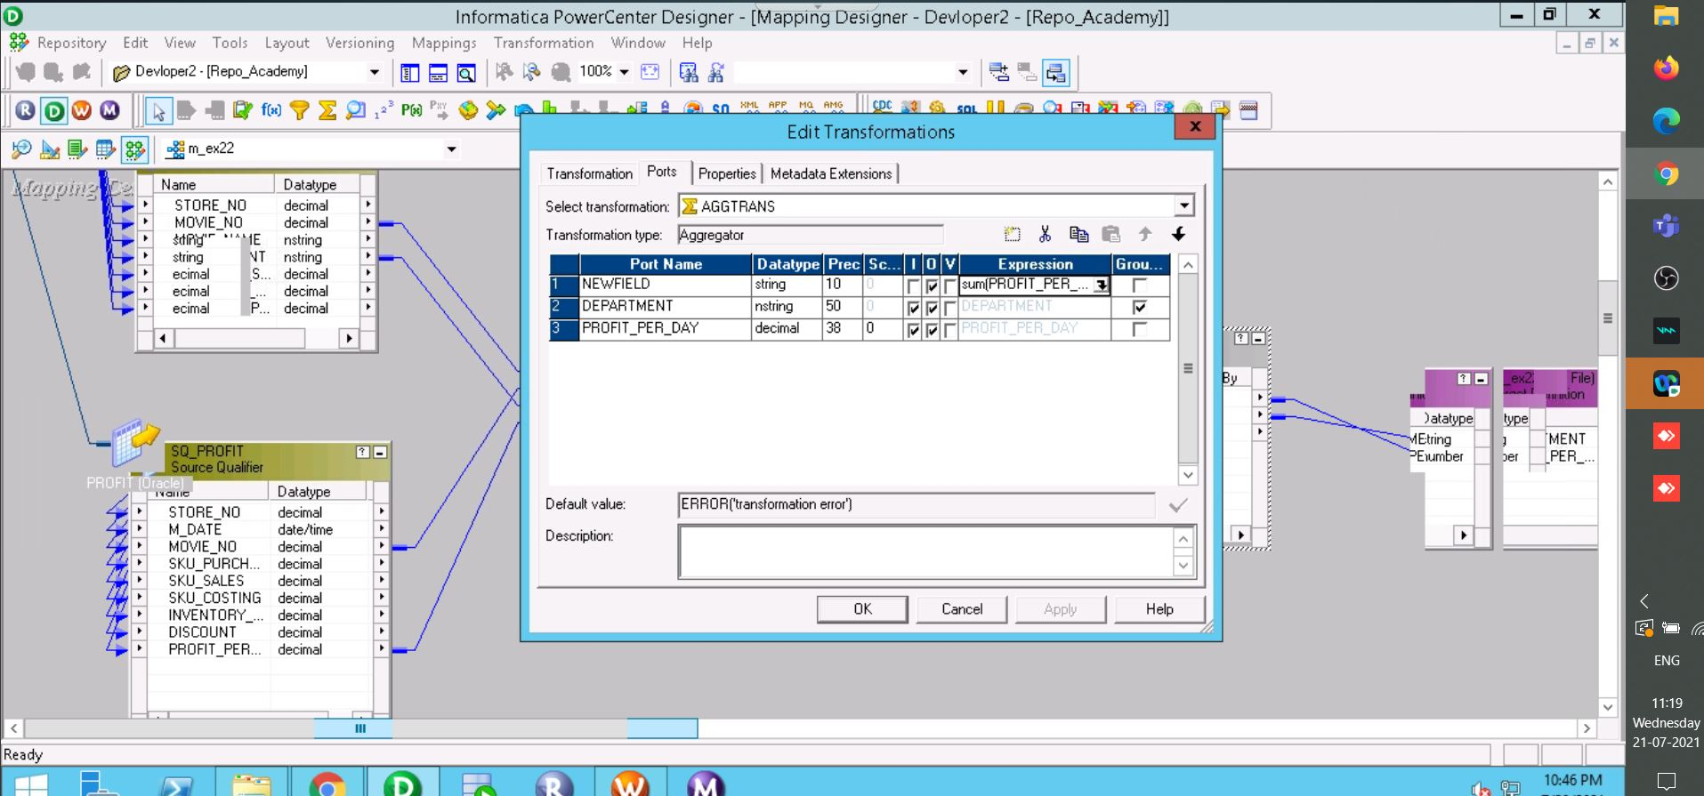
Exercise 2.2 (aggregator transformation):

Slide 22
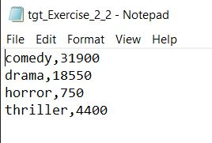
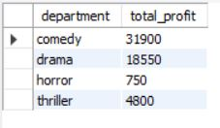
Target and Output 2.2 :

Slide 23
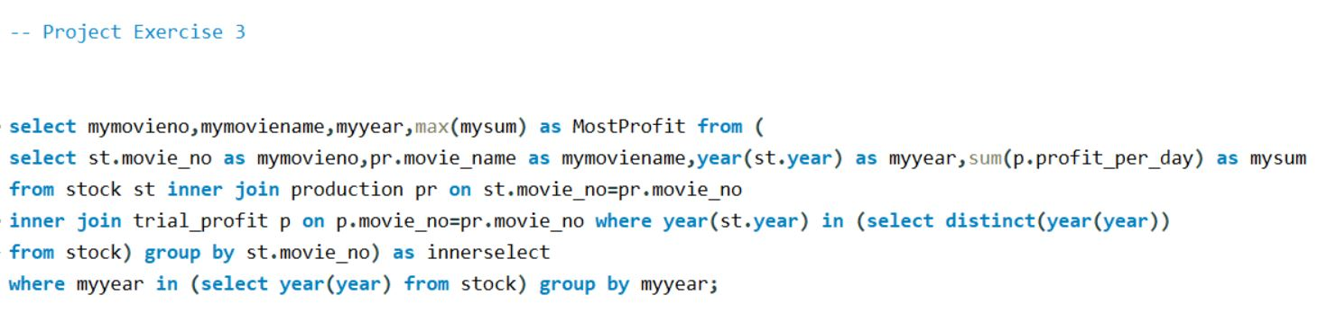
Exercise 3: To generate a report to find the most profitable movie title list in yearly basis.

Slide 24
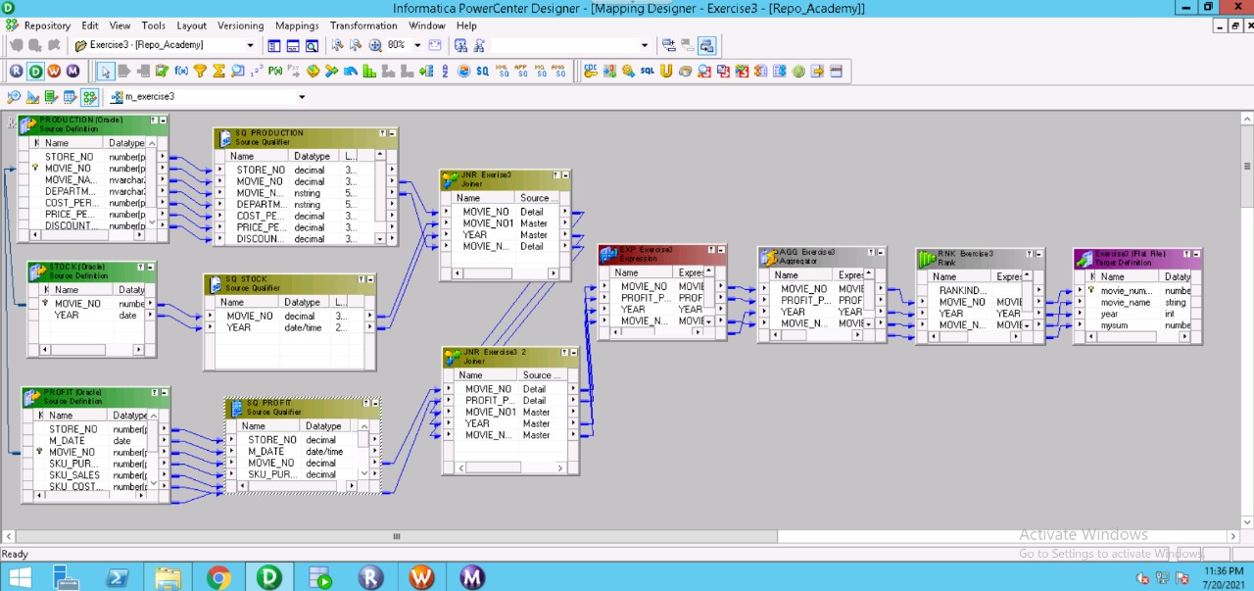
Exercise 3: To generate a report to find the most profitable movie title list in yearly basis.

Slide 25
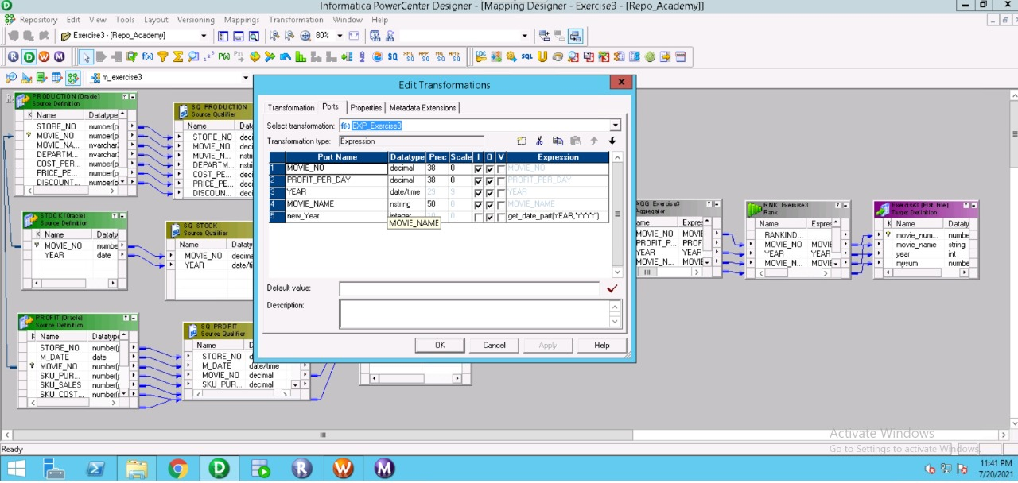
Exercise 3 (expression transformation):

Slide 26

Exercise 3 (aggregator transformation):

Slide 27

Exercise 3 (rank transformation):

Slide 28
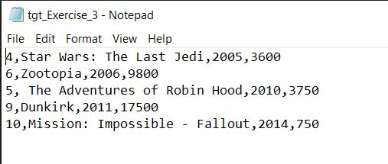
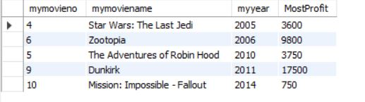
Target and Output 3 :

Slide 29
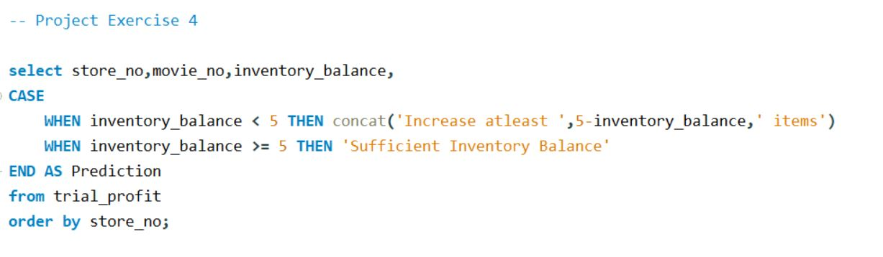
Exercise 4: This is to produce the report by using inventory balance to get the forecasted production.

Slide 30
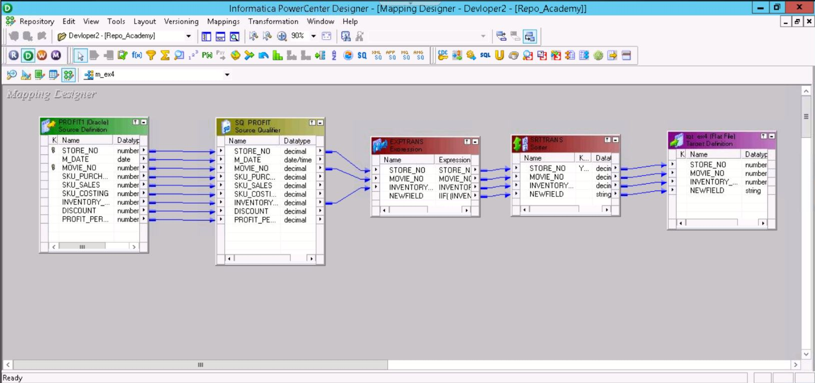
Exercise 4: This is to produce the report by using inventory balance to get the forecasted production.

Slide 31
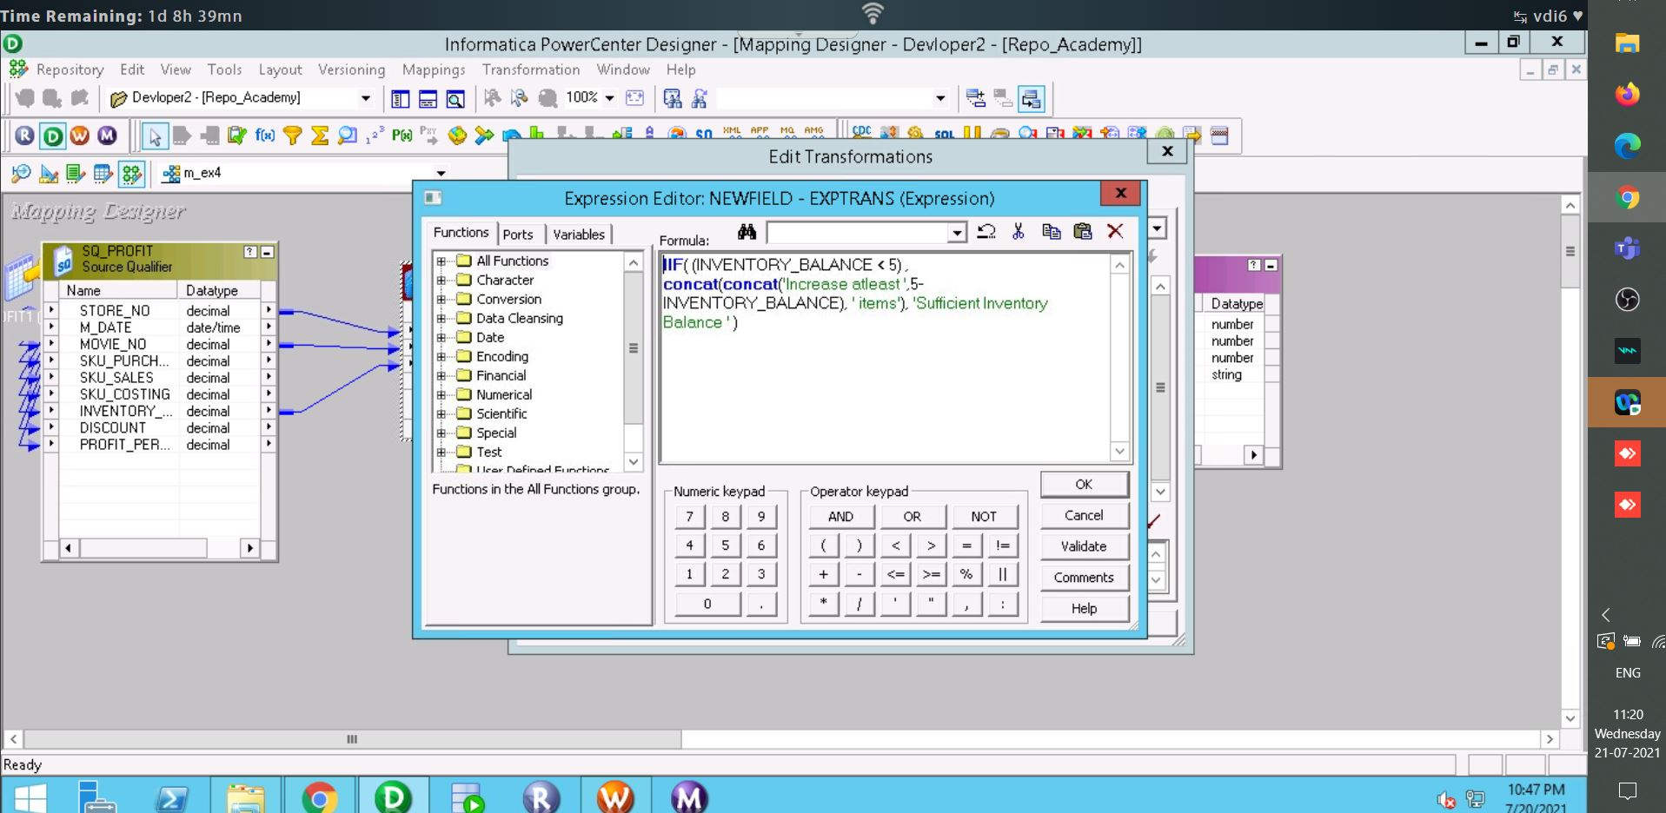
Exercise 4 (expression transformation):

Slide 32
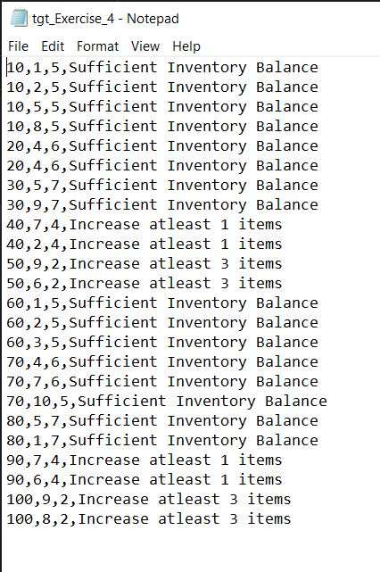
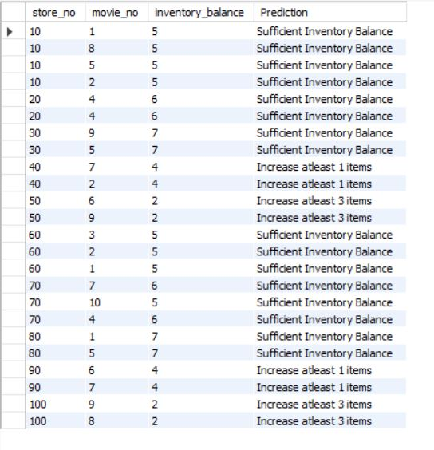
Target and Output 4 :

Slide 33
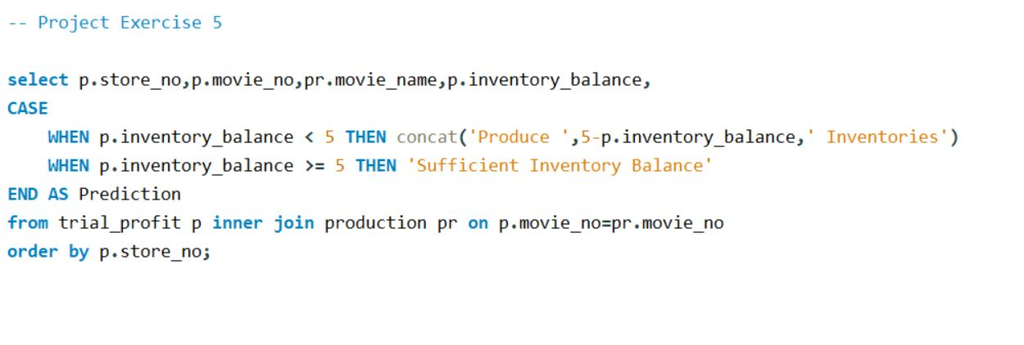
Exercise 5: To find the Production of SKU’s based on Inventory Balance.

Slide 34
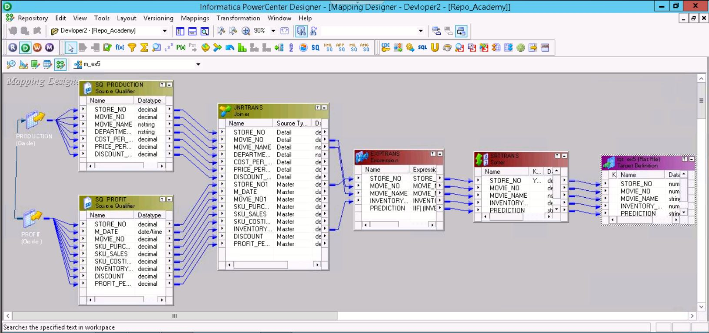
Exercise 5: To find the Production of SKU’s based on Inventory Balance.

Slide 35
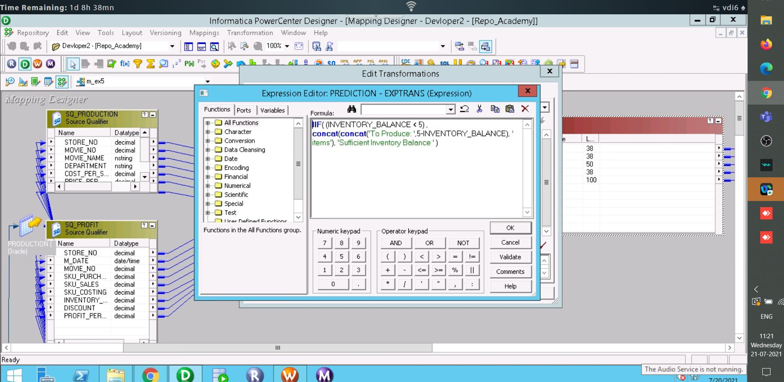
Exercise 5 (expression transformation):

Slide 36
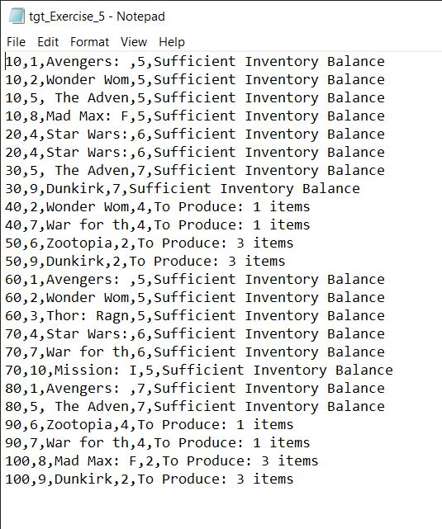
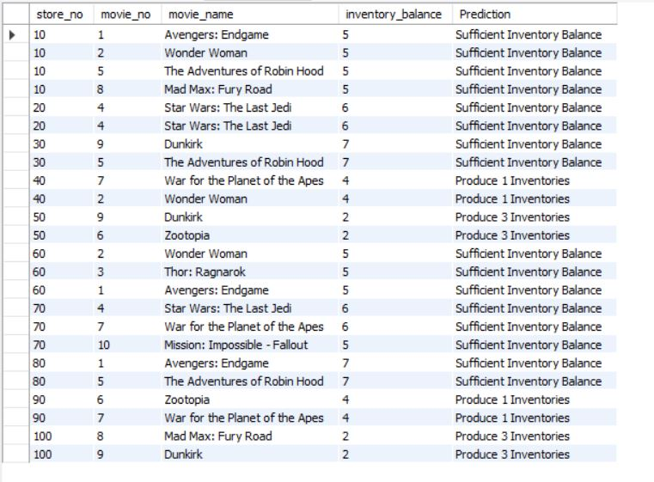
Target and Output 5 :

Slide 37
Thank You !

